Slide 1
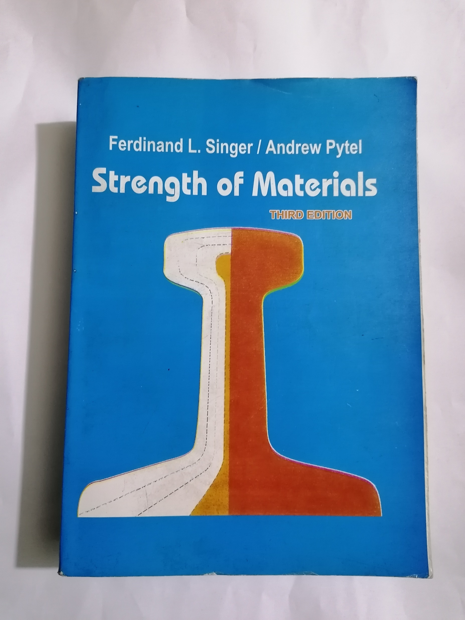
Mechanics of materials
Strength of materials

Slide 2
CH1: Simple stress
1- Normal stress
2- Shearing stress
3- Bearing stress
CH2: Simple strain
1- Stress – strain diagram
2- Hooks law
3- Statically indeterminate members
4- Thermal stresses
CH3: Torsion

Slide 3
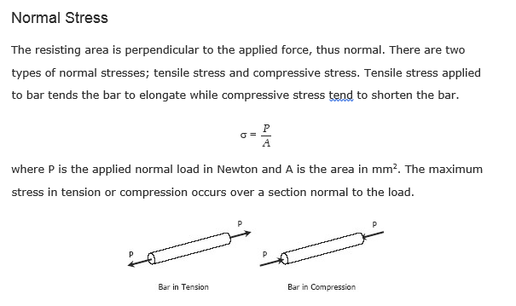

Slide 4
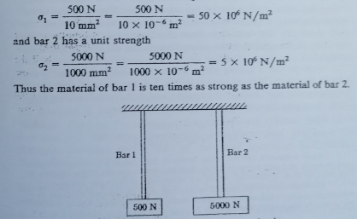

Slide 5
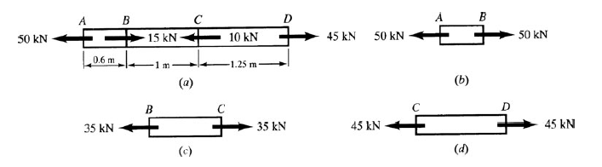
A = 500mm²
σ = P/A
b: σ = 50 x 10³/500 x 10⁻⁶ =100 x 10⁶ N/m² = 100 Mpa
c: σ = 35 x 10³/500 x 10⁻⁶ =70 x 10⁶ N/m² = 70 Mpa
d: σ = 45 x 10³/500 x 10⁻⁶ =90 x 10⁶ N/m² = 90 Mpa

Slide 6
